Slide 1
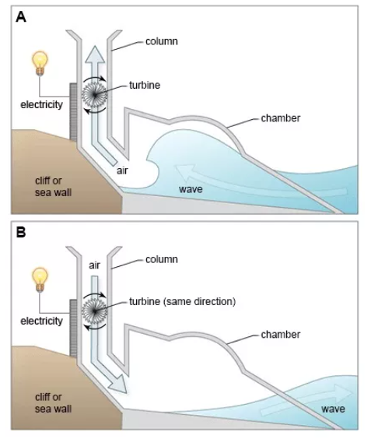
PROCESS DIAGRAM

Slide 2
The diagrams show a structure that is used to generate electricity from wave power.
Summarise the information by selecting and reporting the main features, and make comparisons where relevant.
Write at least 150 words.
Generating Electricity From The Sea

Slide 3
SAMPLE ANSWER
The two diagrams illustrate a method of creating electricity from the force of waves using a specifically designed man-made construction. The structure, consisting of a wave chamber and a tall column containing a turbine, is erected on a steeply sloping coastal cliff or sea wall where it is subject to the movement of the ocean waves.
The first diagram shows how the incoming wave fills a large chamber and forces the air inside this space up the column and through the turbine. The pressure of the air rotates the turbine which generates a current of electricity. The process does not end there for the structure is able to continue producing power as the sea recedes as can be seen in the second diagram.
As the water now flows away from the structure, it draws air back down the column and downwards through the turbine in the same direction as the previous upward flow of air. The turbine continues to turn thus generating even more electricity.
(165 words)
Generating Electricity From The Sea

Slide 4
BREAKDOWN AND EXPLANATION

Slide 5
Identify the Main Features
1) Is it a linear or a cyclical process?
A linear process starts and finishes at different places. It will often involve the manufacture or creation of something, starting with the raw materials going in at one end and the finished product coming out the other end.

Slide 6
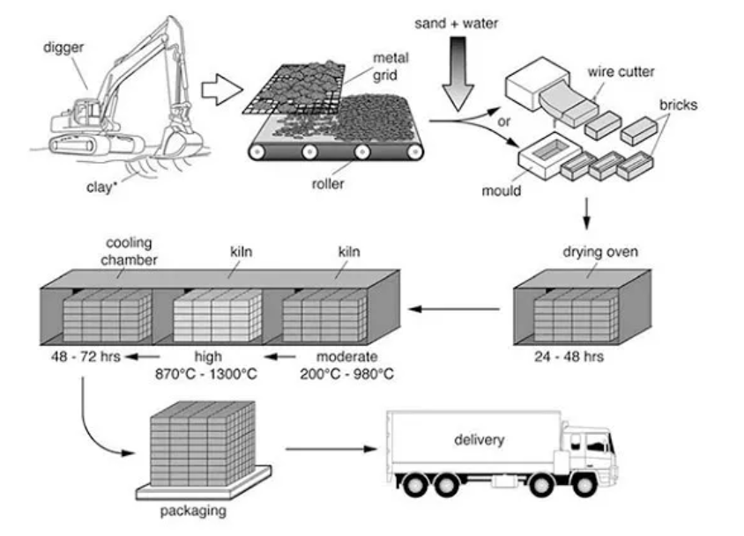
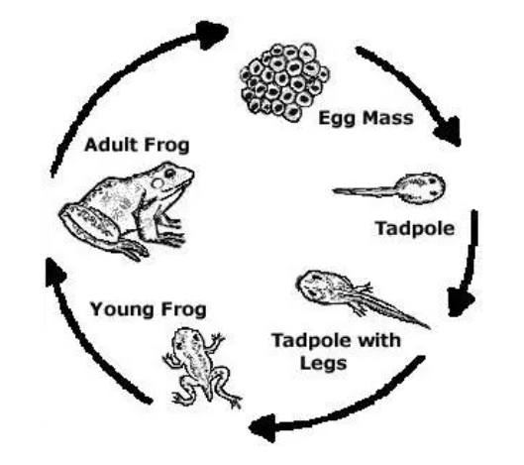
LINEAR
CYCLICAL

Slide 7
Identify the Main Features
2) Where does the process start and end?
For a linear process this will usually be obvious. It may be harder to determine for a cyclical process so it’s important that you examine the graphic carefully to find out.
3) How many steps are there to the process?
If there are a lot, it can be helpful to number them from 1 to whatever number the final stage is.

Slide 8
Identify the Main Features
4) Can the process be easily broken down into stages?
This graphic doesn’t contain very much detail. There are only two stages to the process:
Stage 1: Electricity is generated as the wave flows into the structure (Diagram A).
Stage 2: Electricity is also created as the receding wave draws air back down the column (Diagram B).

Slide 9
Write an Introduction
Question:
The diagrams below show a structure that is used to generate electricity from wave power.
Introduction (Paragraph 1):
The two diagrams illustrate a method of creating electricity from the force of waves using a specifically designed man-made construction.
DO NOT GIVE ANY HEADING
THE HEADINGS OF THE PARAGRAPHS ARE FOR EXPLANATION ONLY
YOUR WRITING SHOULD ONLY HAVE PARAGRAPHS AS SHOWN IN THE LAST SLIDE

Slide 10
Write an Overview
Generating Electricity From The Sea
Stage 1: Electricity is generated as the wave flows into the structure (Diagram A).
Stage 2: Electricity is also created as the receding wave draws air back down the column (Diagram B).
Overview (Paragraph 1):
The structure, consisting of a wave chamber and a tall column containing a turbine, is erected on a steeply sloping coastal cliff or sea wall where it is subject to the movement of the ocean waves.
DO NOT GIVE ANY HEADING
THE HEADINGS OF THE PARAGRAPHS ARE FOR EXPLANATION ONLY
YOUR WRITING SHOULD ONLY HAVE PARAGRAPHS AS SHOWN IN THE LAST SLIDE

Slide 11
Paragraph-1 (Intro+Overview)
The two diagrams illustrate a method of creating electricity from the force of waves using a specifically designed man-made construction. The structure, consisting of a wave chamber and a tall column containing a turbine, is erected on a steeply sloping coastal cliff or sea wall where it is subject to the movement of the ocean waves.

Slide 12
Write the 1st Detail Paragraph
Generating Electricity From The Sea
Stage 1: Electricity is generated as the wave flows into the structure (Diagram A).
Paragraph 2:
The first diagram shows how the incoming wave fills a large chamber and forces the air inside this space up the column and through the turbine. The pressure of the air rotates the turbine which generates a current of electricity. The process does not end there for the structure is able to continue producing power as the sea recedes as can be seen in the second diagram.
DO NOT GIVE ANY HEADING
THE HEADINGS OF THE PARAGRAPHS ARE FOR EXPLANATION ONLY
YOUR WRITING SHOULD ONLY HAVE PARAGRAPHS AS SHOWN IN THE LAST SLIDE

Slide 13
Write the 2nd Detail Paragraph
Generating Electricity From The Sea
Stage 2: Electricity is also created as the receding wave draws air back down the column (Diagram B).
Paragraph 3:
As the water now flows away from the structure, it draws air back down the column and downwards through the turbine in the same direction as the previous upward flow of air. The turbine continues to turn thus generating even more electricity.
DO NOT GIVE ANY HEADING
THE HEADINGS OF THE PARAGRAPHS ARE FOR EXPLANATION ONLY
YOUR WRITING SHOULD ONLY HAVE PARAGRAPHS AS SHOWN IN THE LAST SLIDE

Slide 14
SAMPLE ANSWER
The two diagrams illustrate a method of creating electricity from the force of waves using a specifically designed man-made construction. The structure, consisting of a wave chamber and a tall column containing a turbine, is erected on a steeply sloping coastal cliff or sea wall where it is subject to the movement of the ocean waves.
The first diagram shows how the incoming wave fills a large chamber and forces the air inside this space up the column and through the turbine. The pressure of the air rotates the turbine which generates a current of electricity. The process does not end there for the structure is able to continue producing power as the sea recedes as can be seen in the second diagram.
As the water now flows away from the structure, it draws air back down the column and downwards through the turbine in the same direction as the previous upward flow of air. The turbine continues to turn thus generating even more electricity.
(165 words)
Generating Electricity From The Sea

